Slide 1
Applied Data Science 2
Dr Ashley SpindLer
Semester A, 2023

Slide 2
Lecture 3 - Outcomes
Review how queries are computed in stages
Understand how to group data and use aggregate functions

Slide 3
Staging Queries

Slide 4
Staging Queries
Python Driver
SparkContext
Worker
Worker
Worker
Worker
Executor
Executor
Executor
Executor
Task
Task
Task
Task
Task
Task
Task
Task

Slide 5
Scenario 1 – Filtering Dice
1
1
3
5
5
2
5
3
1
3
4
6
6
2
6
2
6
Driver
6
5
4
6
6
2
1
1
5
6

Slide 6
Scenario 1 – Filtering Dice
1
1
3
5
5
5
3
2
5
3
1
4
6
6
2
6
2
6
Driver
6
5
4
6
6
2
1
1
6
Partition

Slide 7
Scenario 1 – Filtering Dice
Driver
Partition

Slide 8
Scenario 1 – Filtering Dice
Driver

Slide 9
Scenario 1 – Filtering Dice
Discard any dice with a face
value of 3 or lower
Driver
5
6
5
6
5
4
6
6
5
6
4
6
6
6
5

Slide 10
Scenario 1 – Filtering Dice – Complete!
5
5
4
6
6
6
6
6
6
5
Driver
5
4
6
5
6

Slide 11
Scenario 2 – Counting Dice
1
1
3
5
5
2
5
3
1
3
4
6
Count the number of dice with
face value of 4 or higher
6
2
6
2
6
Driver
6
5
4
6
6
2
1
1
5
6
Partition

Slide 12
Stage 1: Local Count
Count the number of dice with
face value of 4 or higher
Driver

Slide 13
Stage 1: Local Count
Count the number of dice with
face value of 4 or higher
Driver
5
6
5
6
5
4
6
6
5
6
4
6
6
6
5

Slide 14
Stage 1: Local Count
Count the number of dice with
face value of 4 or higher
Driver
2
2
3
2
2
0
1
3

Slide 15
Stage 1: Local Count – Complete!
2
2
3
Count the number of dice with
face value of 4 or higher
3
2
2
Driver
0
1

Slide 16
Stage 2: Global Count
2
2
3
Count the number of dice with
face value of 4 or higher
3
2
2
Driver
0
1

Slide 17
Stage 2: Global Count
Count the number of dice with
face value of 4 or higher
Driver
15

Slide 18
Stage 2: Global Count – Complete!
Count the number of dice with
face value of 4 or higher
Driver
15

Slide 19
Stages
1 | read
2 | select
3 | filter
4 | groupBy
5 | filter
6 | count

Slide 20
Stages
Stage 1 | 1 | read
 | 2 | select
 | 3 | filter
 | 4 | groupBy
Stage 2
 | 5 | filter
 | 6 | count

Slide 21
Shuffles Introduce Stage Boundaries
Stage 1 | 1 | read
 | 2 | select
 | 3 | filter
 |  | groupBy / shuffle write
Stage 2 |  | shuffle read / groupBy
 | 5 | filter
 | 6 | count

Slide 22
Subsequent executions can skip the first stage
Stage 1 | 1 | read
 | 2 | select
 | 3 | filter
 |  | groupBy / shuffle write
Stage 2 |  | shuffle read / groupBy
 | 5 | filter
 | 6 | count
Skipped

Slide 23
Aggregation

Slide 24
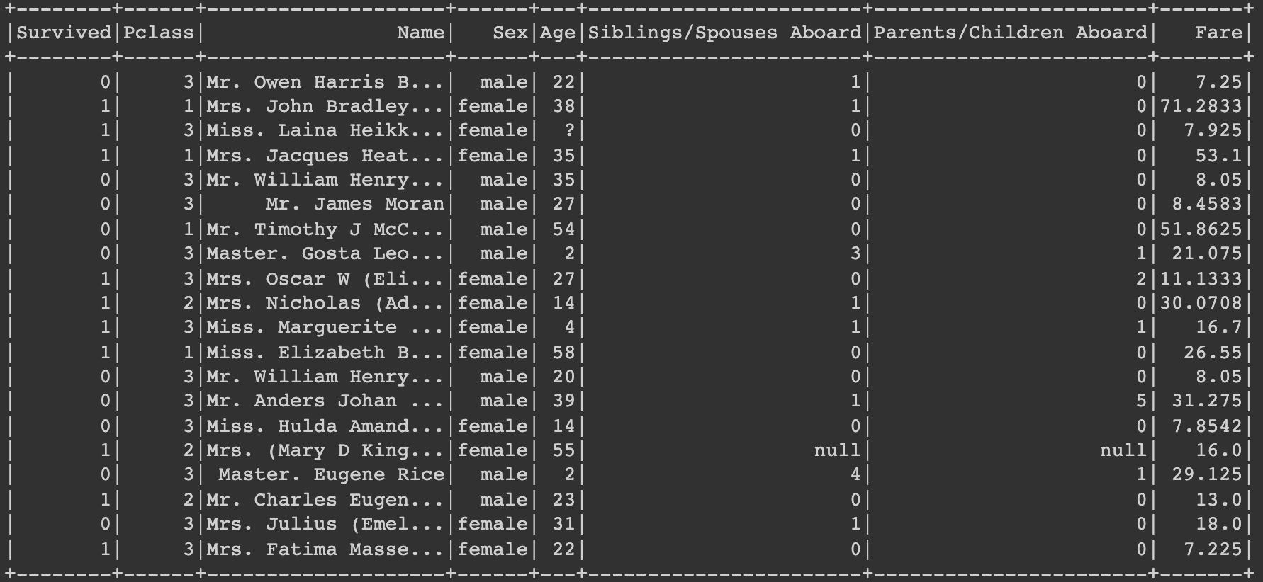
Grouping Data
Say we want to calculate the average fare paid by passengers in the first, second and third classes of the Titanic

Slide 25
groupBy(“Pclass”).mean(“Fare”)
1 | 51.86
2 | 30.07
1 | 26.55
3 | 7.25
2 | 16.00
3 | 16.70
1 | 39.21
2 | 23.04
3 | 11.98
Local
Mean
1 | 39.21
2 | 23.04
3 | 11.98
Global
Mean
1 | 71.28
2 | 16.90
1 | 53.10
3 | 7.92
2 | 13.00
3 | 7.23
1 | 62.19
2 | 14.95
3 | 7.58
Local
Mean

Slide 26
Group Data Objects
Df.groupBy() creates a “Grouped Data Object”, which has a number of aggregation methods. (GroupedData API)
There are also Built-in aggregate functions which can be called using the .agg() method. (Built-in Functions)

Slide 27
Aggregation Demo

Slide 28
Review
Queries are executed in stages, such as between performing a local count on each partition of data, then feeding the data into a global count
GroupedData can be acted upon by using Aggregate functions, for example calculating the sum or mean of numerical values across groups of data in one column

Slide 29
Questions???

